Slide 1
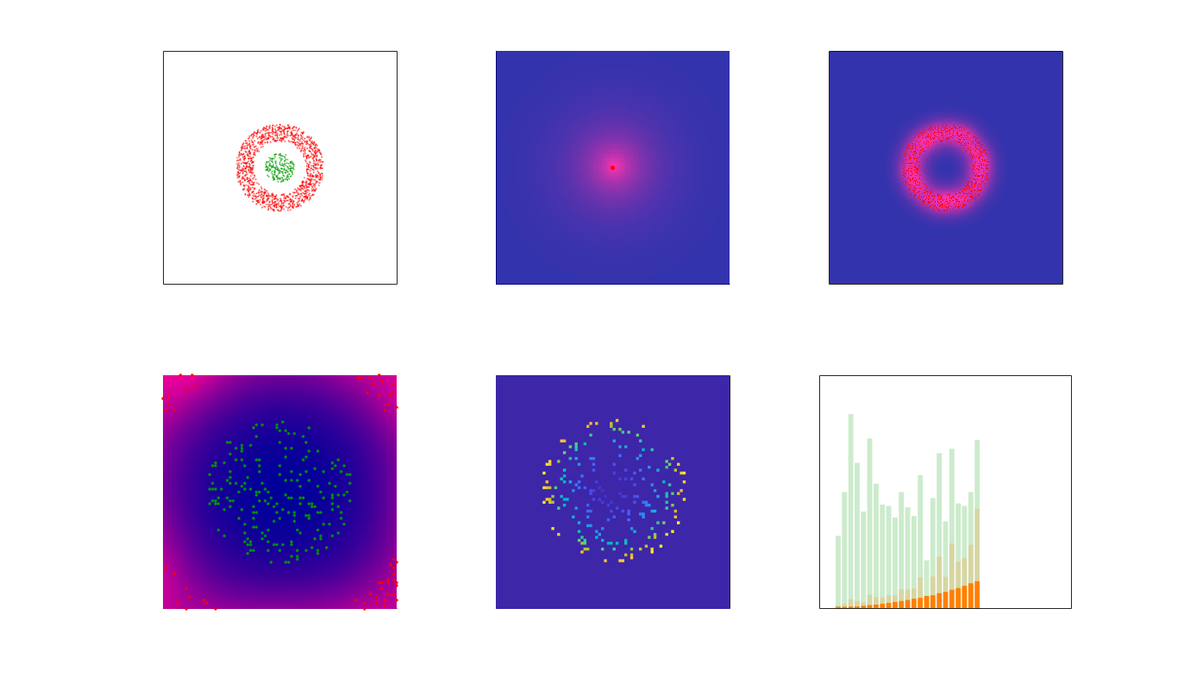
Fig. S7 - Model 3 – TCR phosphorylation (TP) – output data

Slide 2
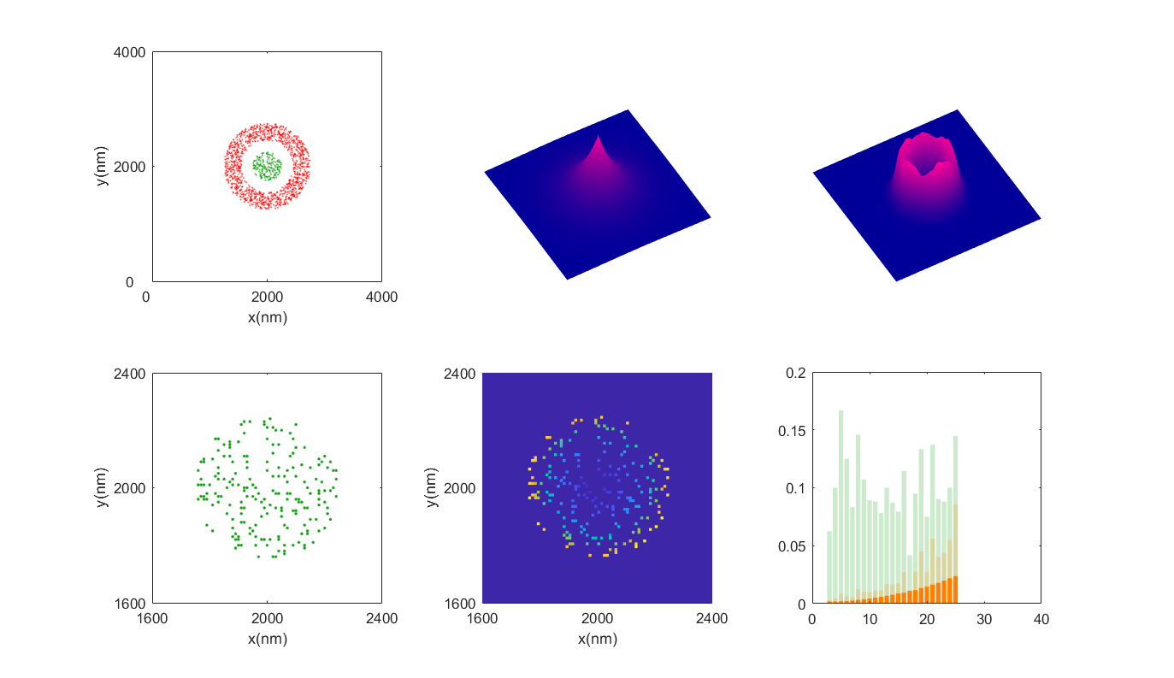
Fig. S7 - Model 3 – TCR phosphorylation (TP) – output data
A
Points pattern
B
One Lck* distribution
C
All Lck* distributions
TCR
CD45
400
4000
y(nm)
400
y(nm)
4000
-400
x(nm)
0
x(nm)
-400
0
-400
D
TCR locations
E
TCR* probability
F
Radial TCR* probability
400

